Slide 1
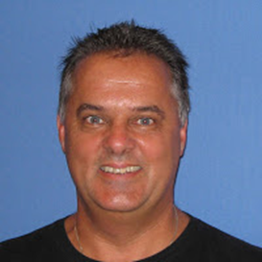
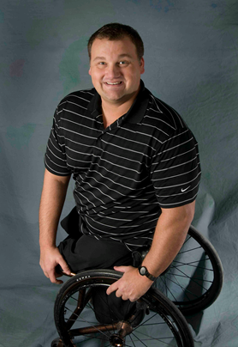
Southeast Regional AHEAD Conference
SPEAKERS
Stephen Gray
North Carolina- AHEAD President
Stephan Smith AHEAD Executive Director
Matt Glowacki
Disability Consultant
http://mattglowacki.com/website_alt.html
Conference Host:
Winthrop University
MAY 18-19,2017
Accepting PROPOSALS: CLICK HERE

